Slide 1
Chapter 18
Using a Media Management Layer

Slide 2
Background
This was the most difficult chapter in the book to cover adequately, last chapter written in the book
A large matrix of configurations: several different vendors, different versions of vendor software, different versions of software for different hardware platforms, different versions of Oracle
Authors tried to cover in a generic way in one chapter material that could actually be a book (or set of books) by itself

Slide 3
MML
Default for RMAN is to backup to disk
RMAN will automatically allocate one disk channel
If you want to backup directly to tape, you must use a MML
MML is a 3rd party piece of software that manages the backups directly to tape

Slide 4
MML Vendors
Many different MML vendors
Three MML vendors covered in this set of slides:
  Oracle Secure Backup
  Veritas NetBackup
  EMC Networker

Slide 5
Oracle Secure Backup
Oracle Secure Backup (OSB) is a MML provided by Oracle
Contains most features of a MML
OSB is a low cost solution

Slide 6
OSB Architecture
Administrative server
Media server
Client
Obtool

Slide 7
Backing Up with OSB
Allocate channel device type sbt …
Backup commands work the same as with disk
RMAN> backup database;
Writes to tape if device type sbt

Slide 8
Veritas NetBackup
Setup of MML is often the most difficult task
Secure a license
Prepare hardware
Install NetBackup
Check configuration

Slide 9
Veritas Architecture
Database
Media Server (optional)
Master Server
Tape Library
Netbackup client

Slide 10
Using NetBackup
Allocate channel c1 type sbt_tape;
RMAN commands will now communicate with MML to read/write to tape
Backup and restore commands should work the same as when writing to disk

Slide 11
EMC NetWorker
Previously Legato NetWorker
Suit of tools for storage management
EMC NetWorker Module for Oracle (NMO) contains APIs that allow RMAN to communicate with tape

Slide 12
NMO Architecture Components
NetWorker client
NMO MML
NetWorker Server
NetWorker Administrator
Storage Device

Slide 13
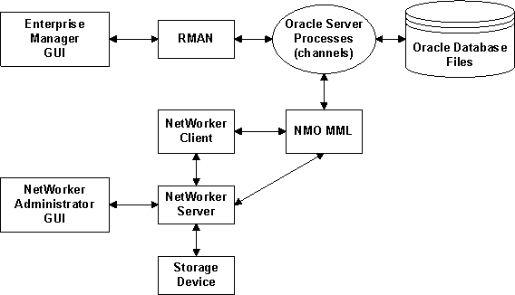
NMO Architecture Diagram

Slide 14
NMO and RMAN
Just like OSB and NetBackup, configure channel type to sbt_tape
RMAN backup and restore commands work with tape device to write/read backups
RMAN> backup database;
RMAN> restore database;

